Slide 1
Infuse AI in your Windows apps with Windows Copilot Runtime and .NET
Nikola Metulev
@metulev

Slide 2
Windows Copilot Runtime
Applications + Experiences
Windows Copilot Library + On-device models
AI frameworks + toolchain
Silicon

Slide 3
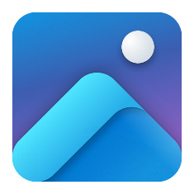
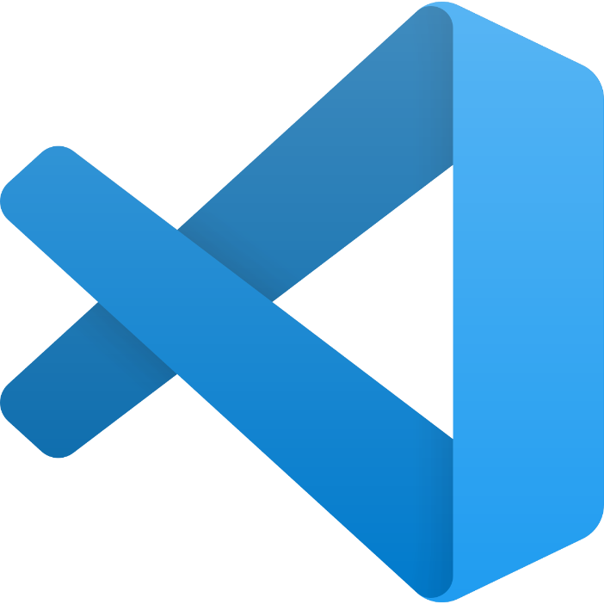


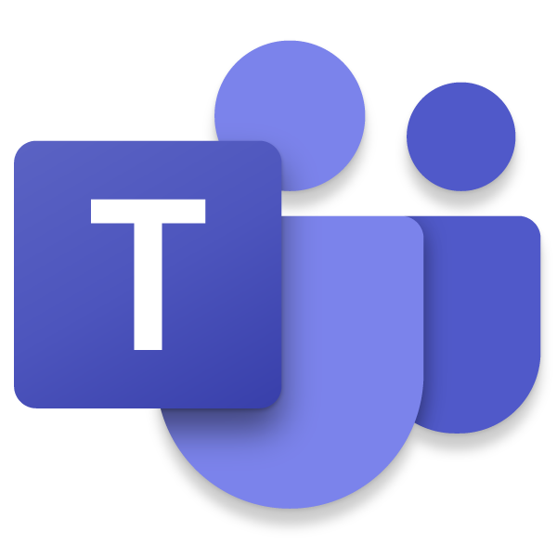
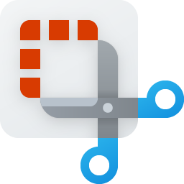

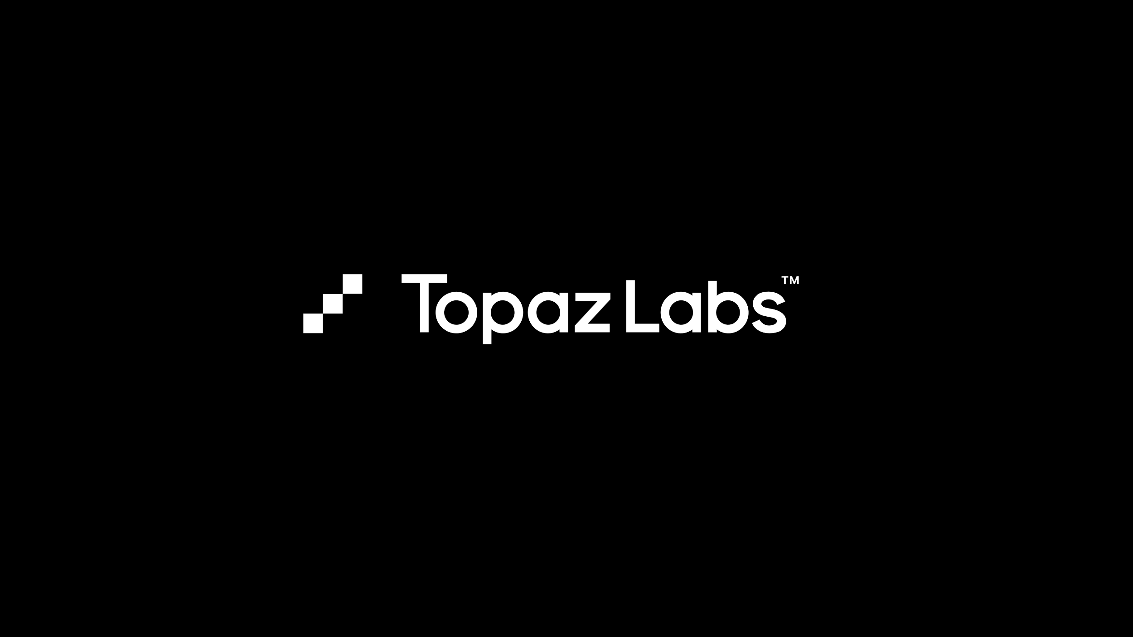

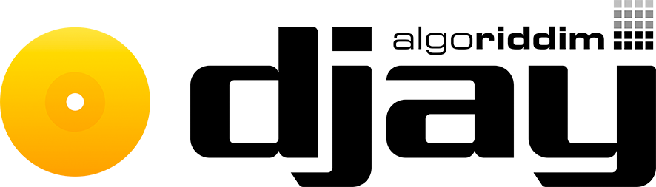



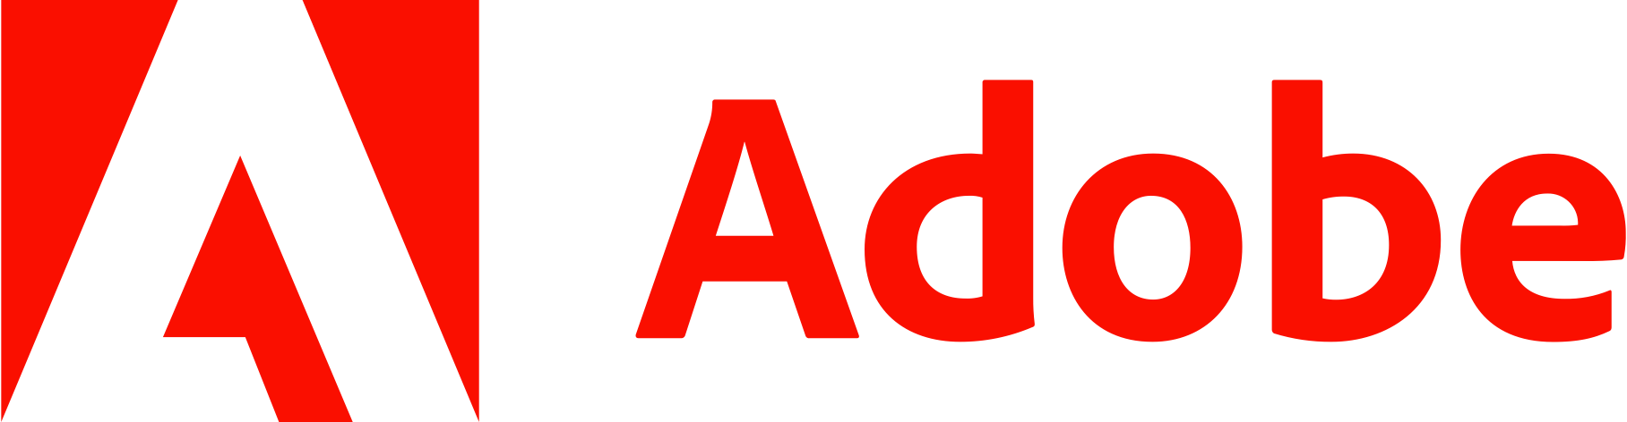

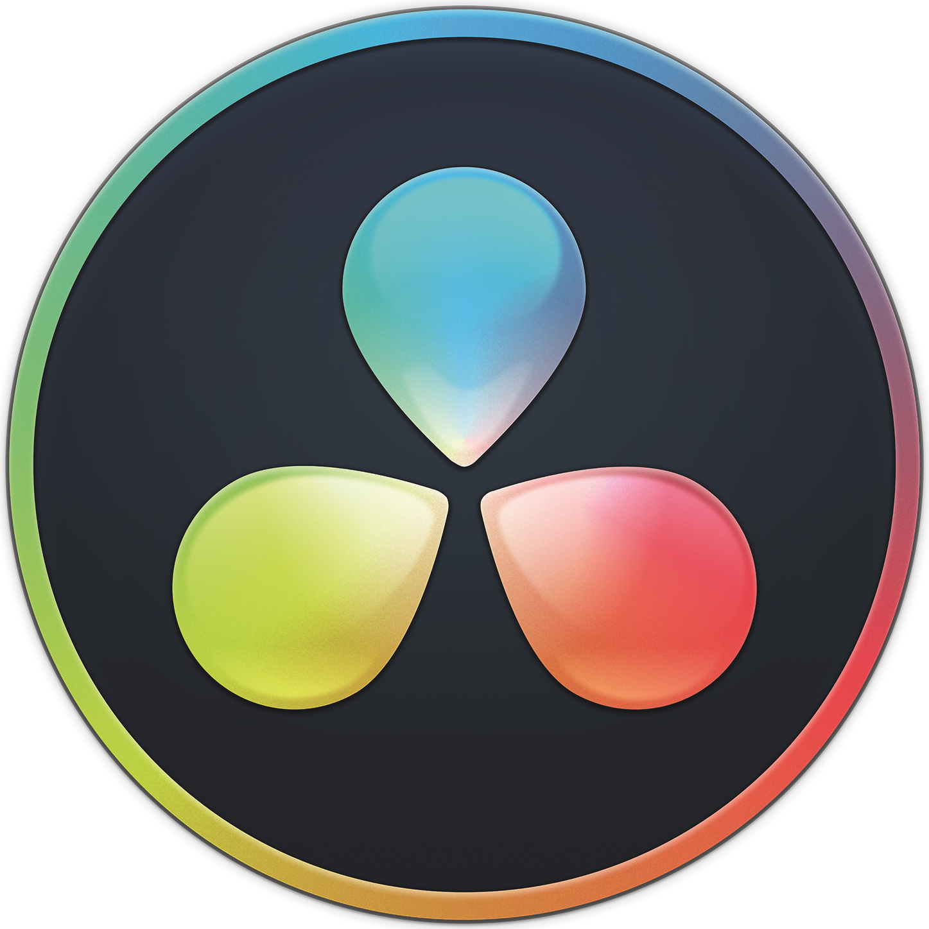
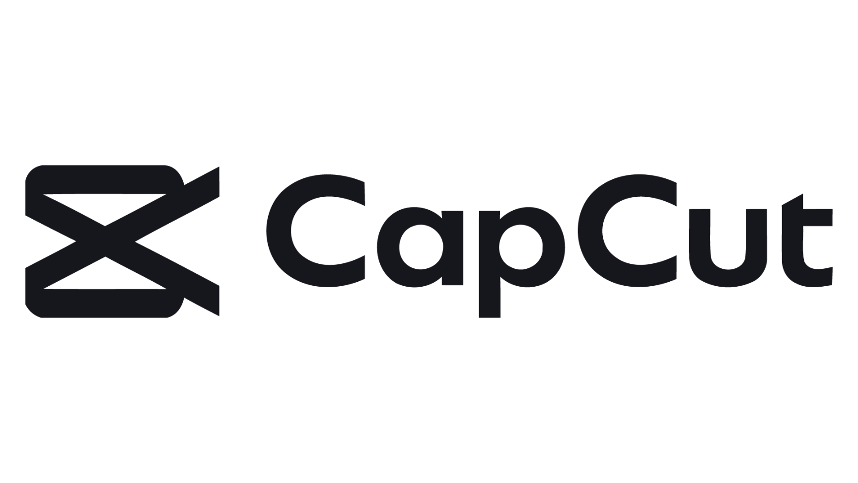
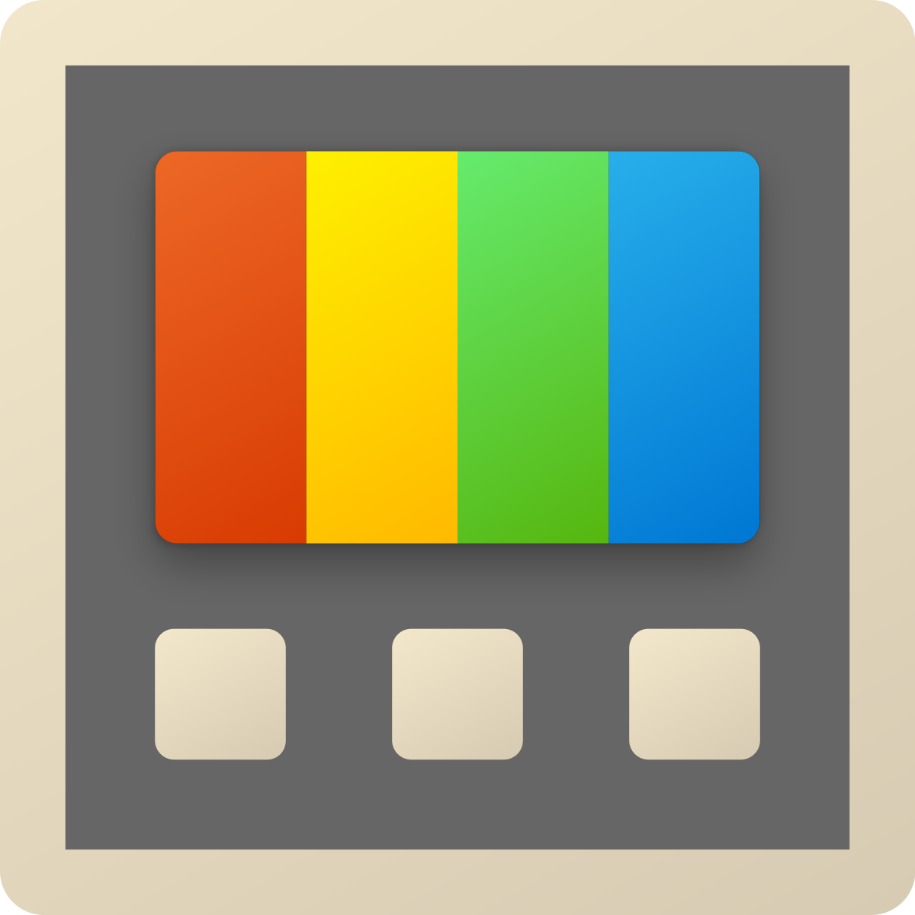
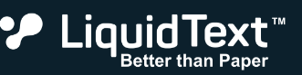
Applications and Experiences built using the Windows Copilot Runtime
Applications + Experiences
Windows Copilot Library + On-device models
AI frameworks + toolchain

Slide 4
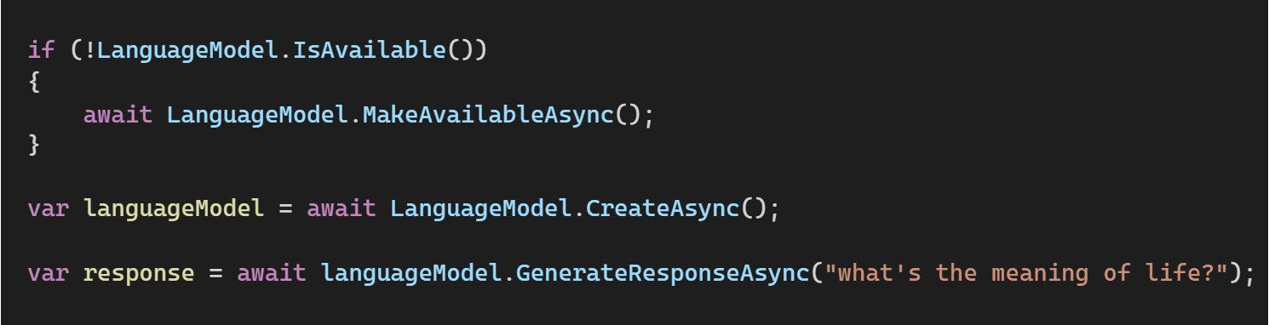
Windows Copilot Library
Applications + Experiences
Windows Copilot Library + On-device models
APIs backed by on device ML models
AI frameworks + toolchain
Phi Silica and Text Recognition will be available in an upcoming WinAppSDK experimental release
Vector Embeddings, RAG, Text Summarization and more will follow

Slide 5


DirectML
Applications + Experiences
Windows Copilot Library + On-device models
AI frameworks + toolchain
High-performance, hardware-accelerated DirectX 12 library for machine learning on Windows
A single, hardware-abstraction API for optimization and deployment, that scales across hardware
Full GPU support and expanding to include NPUs for full breadth of hardware support with AMD, Intel, Nvidia, and Qualcomm
Support for 4-bit Activation-Aware Quantization (AWQ) for minimal impact on accuracy to enable more models across Windows hardware
Available as NuGet package or as part of Windows 10 SDK or newer
DirectML
DirectML graph
Graph compiler
Compiled graph
DDI (device driver interface)
DirectX User Mode Driver (UMD)
DXIL
MCDM/WDDM (KMD)
Native Kernels
NPU
GPU
AI

Slide 6
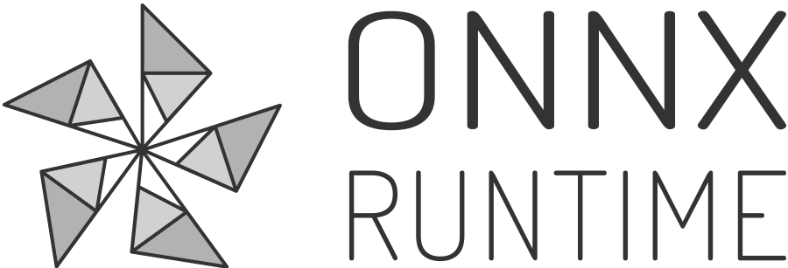
ONNX, ONNX Runtime (ORT), ORT GenAI, Olive
Applications + Experiences
Windows Copilot Library + On-device models
AI frameworks + toolchain
ONNX = Open and interoperable file format for ML and DNN models.
ONNX Runtime = Fast and efficient model inference and training engine that works across a diverse range of hardware accelerators.
ORT Generate API (ORT GenAI) = High performance, easy-to-use API for GenAI models
Olive = A toolkit for hardware-aware AI model optimization.
`
ONNX Model
In-Memory Graph
Graph Partitioner
Provider Registry
Output Result
Graph Optimization
Input Data
Executor/Graph Runner (Sequential/Parallel)
DirectML
Hardware Accelerators
GPU
NPU

Slide 7
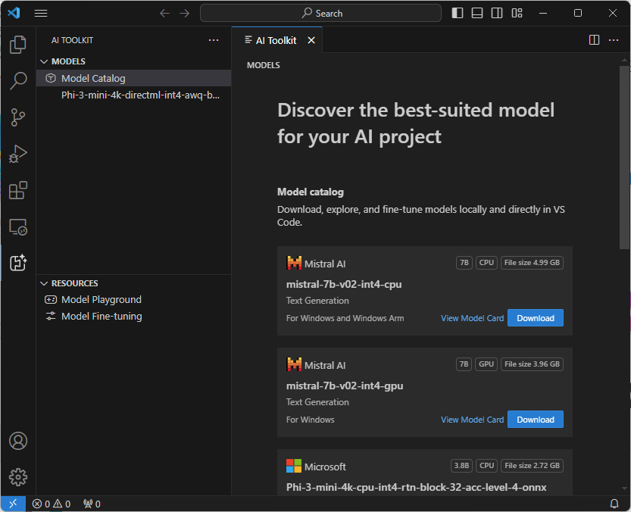
AI Toolkit for VS Code
Applications + Experiences
Windows Copilot Library + On-device models
AI frameworks + toolchain
End-to-end AI Developer toolkit
Download and experiment with Generative AI models, locally
Fine-tune and optimize your model with Olive.
Deploy your AI application and model to the cloud or on-device

Slide 8
aka.ms/wcr
Get started with Windows Copilot Runtime

Slide 9

.NET Conf: Focus on AI
Learn more
aka.ms/dotnetFocusAI/Collection

Slide 10
Developer stack for running ML models
FRAMEWORK
ONNX with ONNXRuntime
PyTorch or
TorchScript with libtorch
GGUF with
llama.cpp / llamasharp
…
HW API
DirectML
NVIDIA CUDA
AMD
Vitis AI
INTEL OpenVINO
QUALCOMM SNPE/ QNN
…
LOCAL ACCELERATORS
CPU
NVIDIA
GPU
AMD
GPU/NPU
INTEL
GPU/NPU
QUALCOMM
NPU
…
Notes:
The most popular frameworks today are PyTorch and ONNX for the AI models.
Most of the models are trained in PyTorch, so most likely you will see the public models being the PyTorch. PyTorch is an open-source machine learning library based on the Torch library, widely used for applications such as natural language processing. It was primarily developed by Facebook's AI Research lab (FAIR). PyTorch is known for its flexibility and ease of use, particularly in research and development environments, but it is also robust enough for production deployment.
ONNX, which stands for Open Neural Network Exchange, is an open format designed to represent machine learning models. It facilitates model interoperability and portability across different machine learning frameworks and tools. This means that developers can train a model in one framework (like PyTorch or TensorFlow) and then deploy it in another, or use it in an environment where the original framework might not be available or ideal
You cannot just add that public model that you downloaded from public sites to your application.
First, you have to optimize it for your hardware. There are number of tools and APIs will help you do that today.
ONNX Runtime is a performance-focused engine for Open Neural Network Exchange (ONNX) models, which is an open-source format used to represent machine learning models. It's developed by Microsoft and part of the larger ONNX ecosystem that aims to create an open ecosystem for interchangeable AI models. ONNX Runtime essentially enables developers and businesses to optimize the performance of their machine learning models and deploy them across various platforms without having to worry about underlying hardware compatibilityYou can learn more about ORT at the ORT session.
DirectML, which stands for DirectX Machine Learning, is a high-performance, low-level API for Windows developed by Microsoft. It is part of the DirectX family and is designed to accelerate machine learning inference on Windows devices. This makes it particularly useful for developers who need to run AI models efficiently on Windows hardware.

